Slide 1
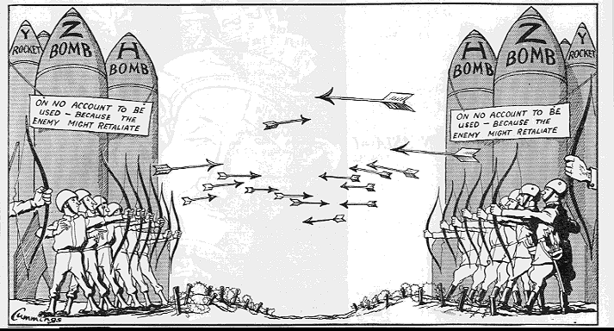
The Cold War 1945-1991

Slide 2
Two sides of Cold War
NATO – North Atlantic Treaty Organization
USA, France, Great Britain, West Germany
CAPITALISM
Warsaw Pact – pro Soviet countries – USSR, and all countries controlled by the USSR.
COMMUNISM

Slide 3
Cold War
The Cold War was a time after WW2 when the USA and the Soviet Union were rivals for world influence.

Slide 4
NATO – North Atlantic Treaty Organization

Slide 6
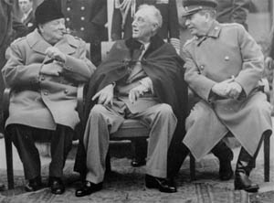
YALTA (in the USSR)
Date: Feb 1945
Present: Churchill,
Roosevelt and Stalin

Slide 7
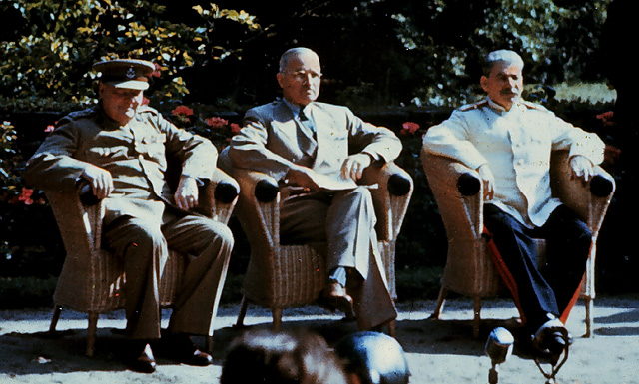
POTSDAM (Germany)
Date: July 1945
Present: Churchill,
Truman and Stalin

Slide 8
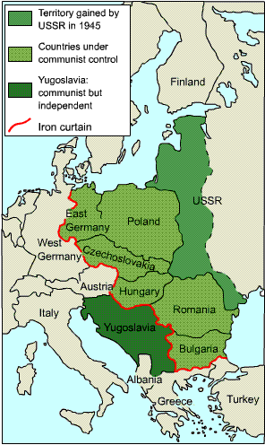
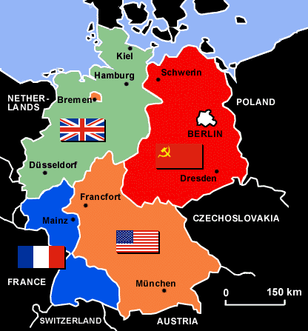
Iron Curtain –
A term used by
Winston Churchill
to describe the
separating of
Those communist
lands of East
Europe from the
West.
Divided Germany

Slide 9
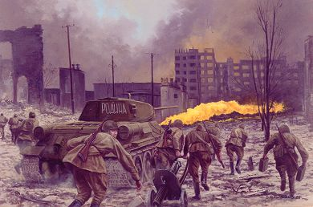
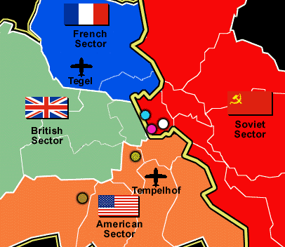
Improve your knowledge
Divided Berlin
The Russians took very high casualties to capture Berlin in May 1945. They spent the early occupation trying to take over all zones of the city but were stopped by German democrats such as Willy Brandt and Konrad Adenauer. Reluctantly the Russians had to admit the Americans, French and British to their respective zones.

Slide 11
Berlin Wall
Berlin is Germany’s capital city.
The Soviets built the wall to keep communists from escaping to the American sector.

Slide 12
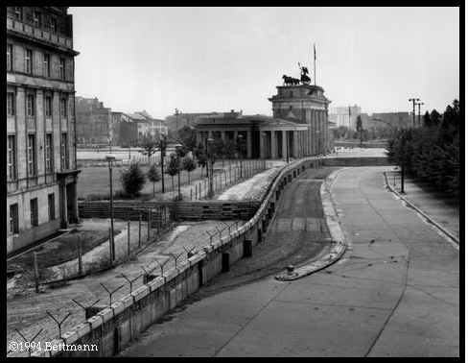
Berlin Wall
Berlin Wall

Slide 13
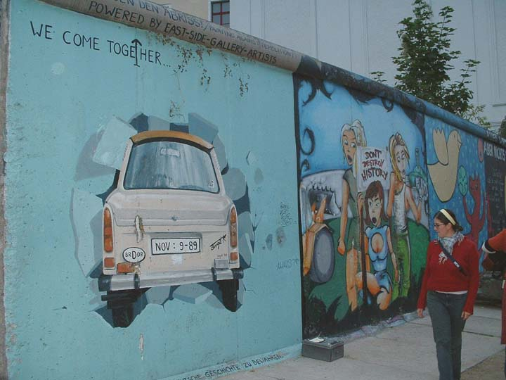

Slide 14
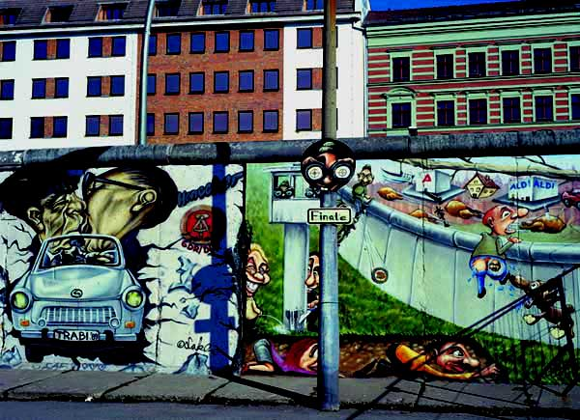

Slide 15
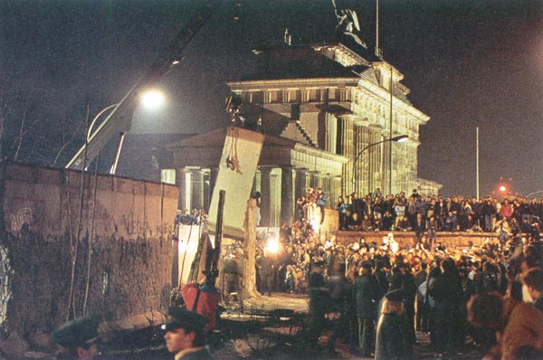
Wall torn down in 1989.

Slide 16
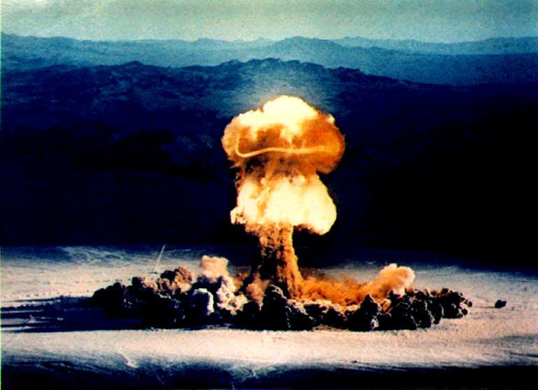
Improve your knowledge
The nuclear bomb gave America a lead which was expected to last at least 5 years. The rapid Russian development of nuclear technology, helped by the work of the “atom spies” was a shock. Significantly, Russia hurriedly declared war against Japan at the beginning of August 1945 and rushed to advance into Asia to stake out a position for the post-war settlement. This helped make both the Korean and Vietnamese conflicts more likely.

Slide 17
Marshall Plan
USA’s plan to send food, blankets, fuel to Europe to help them. AND to keep them from turning communist.

Slide 19
Berlin blockade led to Berlin Airlift

Slide 20
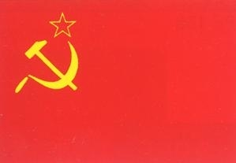
Space Race
The USA and the Soviet Union raced as the world watched to be the first to conquer space.

Slide 21
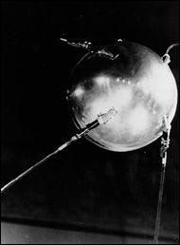
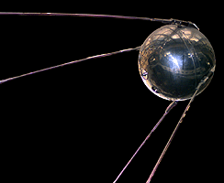
1957 Sputnik – first satellite
Score 1 for Soviets!

Slide 22
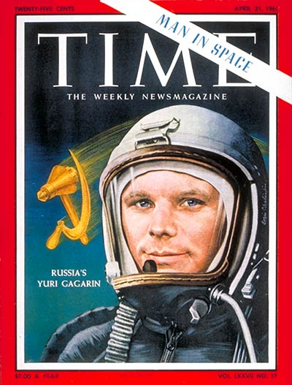
First man in space
Score: USA – 0
Soviets - 2

Slide 23
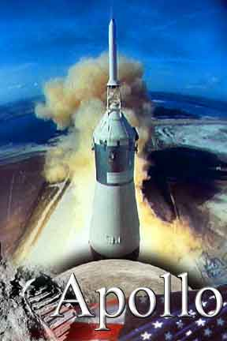
Apollo program
USA spent the 60s trying to catch up to the Soviets.

Slide 24
Armstrong lands on moon!
What is the purpose of a space program?

Slide 25
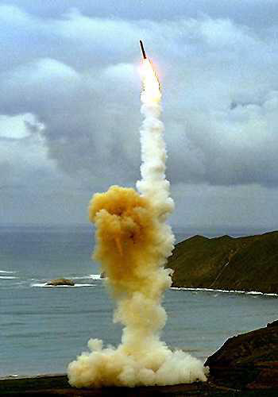
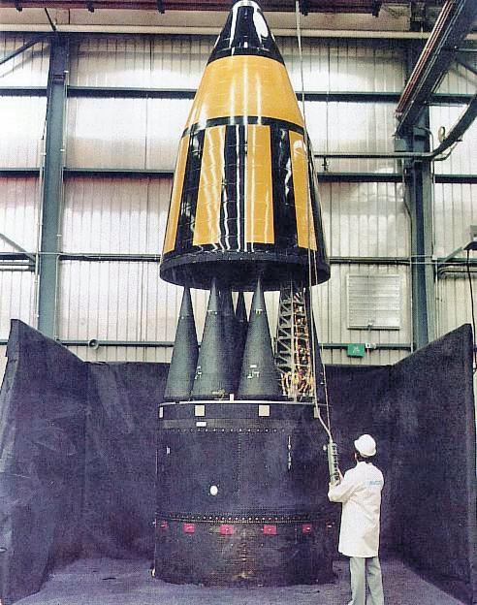
Nuclear Missiles!

Slide 26
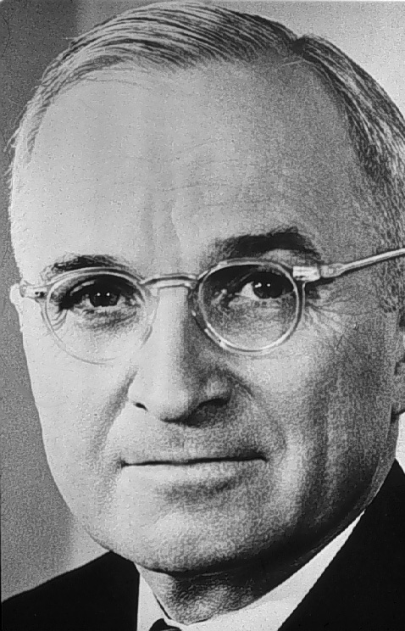
Truman Doctrine
The Truman Doctrine in March 1947 promised that the USA “would support free peoples who are resisting” communism.
This led to containment – policy of containing communism where it is.

Slide 27
Domino Theory
Communism spreads like a disease

Slide 28
Korea and Vietnam
USA tried to contain communism. In both wars, communist troops fought armies trained and funded by the USA.

Slide 29
Communists invaded from the north. China sent a million troops to help reds.

Slide 30
Korean War
After the failure of the promise of Korean independence by the Allied nations, on June 25, 1950, communist North Korean troops invaded South Korea. Poorly armed, the South Koreans were no match for the North. The United Nations ordered North Korea to withdraw its troops. General MacArthur was appointed to command all UN troops in Korea. After three years of fighting a stalemate, more than 54,000 American troops perished.

Slide 31
What is the United Nations?

Slide 32
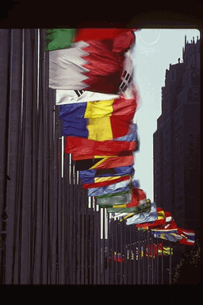
United Nations
International Organization where countries try to find peaceful solutions

Slide 33
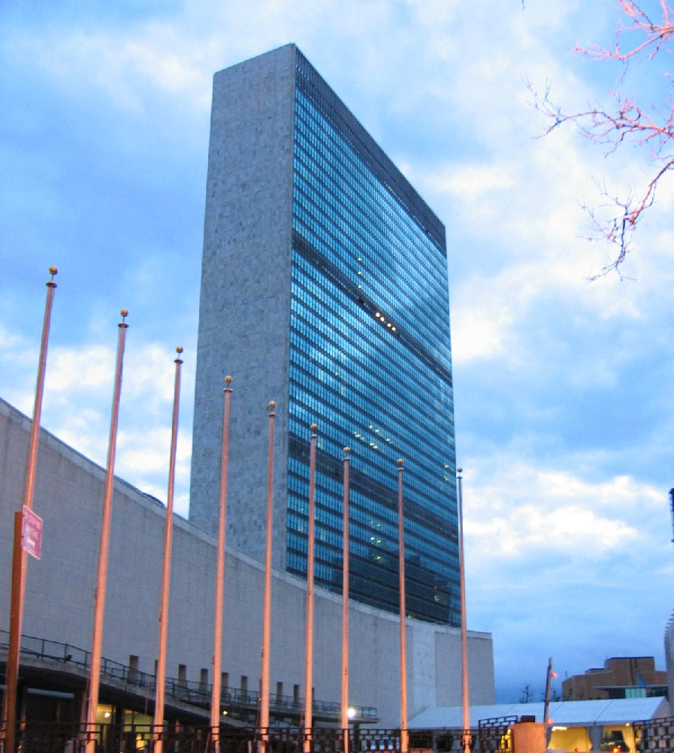
United Nations
It has no army but uses troops from other countries.

Slide 34
Vietnam War 1960s-1973
Through the Kennedy years, US troops trained S. Vietnamese troops to fight the Reds.
After the Gulf of Tonkin Resolution, under LBJ, US troops started to fight more.

Slide 36
Vietnam, 1968

Slide 37
Helicopters!

Slide 38
Napalm!

Slide 40
Seeing this on TV led to a
loss of support at home

Slide 41
Hippie bashing!!!

Slide 42
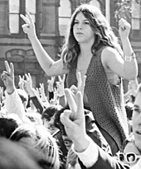
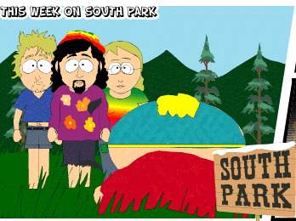
Hippies/Anti-war

Slide 43
Meanwhile. . .
After Korea and before Vietnam got really bad, America felt they had a problem closer to home.

Slide 45
Bay of Pigs
The CIA trained and funded an invasion of communist Cuba. The invasion failed, and Castro had some powerful friends!

Slide 46
Soviet response.
Don’t worry comrade Castro. We got your back!

Slide 48
A U2 spy plane found these missile silos in Cuba, 1962.

Slide 49
Kennedy Khrushchev

Slide 50
People built more bomb shelters.

Slide 51
End to a crisis!
The Soviets removed the missiles in Cuba.
In exchange, USA pledged to not invade Cuba again. And to remove missiles in Turkey (right).

Slide 52
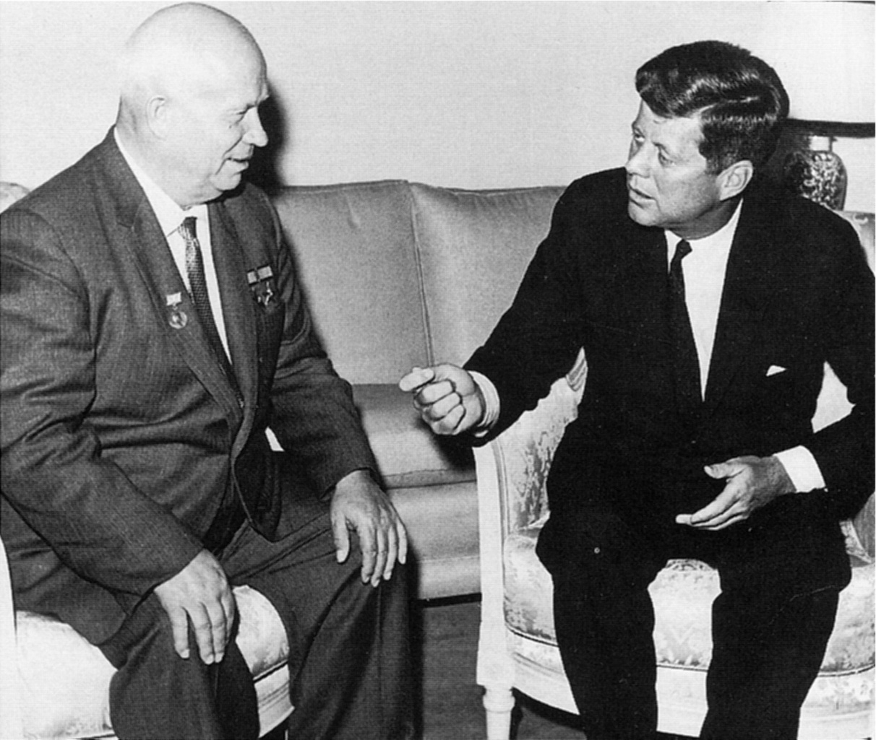
Afterward
A direct phone line was set up between their offices to bypass other channels.

Slide 53
November 22, 1963
LBJ took the Presidency
JFK was shot in Dallas

Slide 54
How did the USA try to contain communism?

Slide 55
Marshall Plan – helped countries economically so they won’t go red.

Slide 56
Helped anti-communist troops

Slide 57
Embargoes
Refusing to trade or aid countries in order to punish them

Slide 58
Cuba embargo
Still today, the USA has an economic embargo on communist Cuba.
Their only cars are from before the embargo!

Slide 59
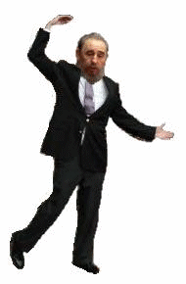
Castro is still alive!

Slide 60
This powerpoint was kindly donated to www.worldofteaching.com
http://www.worldofteaching.com is home to over a thousand powerpoints submitted by teachers. This is a completely free site and requires no registration. Please visit and I hope it will help in your teaching.

